Slide 1
#3 Preparing Your Taxes

Slide 2

Understanding Federal Income Tax Principles
Internal Revenue Service (IRS) responsible for administration and enforcement of federal tax laws
Typical American family pays more than 1/3 of gross income in various taxes

Slide 3
Economics of Income Taxes
Progressive tax structure
The larger the taxable income, the higher the tax rate
As taxable income moves to a higher tax bracket, the higher rate applies only to the additional taxable income

Slide 4
Single Taxpayer 2010 Tax Return
Taxable Income | Tax Rate
$1 to $8,375 | 10%
$8,376 to $34,000 | 15%
$34,001 to $82,400 | 25%
$82,401 to $171,850 | 28%
$171,851 to $373,650 | 33%
Over $373,650 | 35%
Notes:
Description of the table: Ranges of taxable income and their corresponding tax rates are given.

Slide 5
Economics of Income Taxes (continued)
Marginal Tax Rate
Tax rate paid on the next dollar of taxable income
Average Tax Rate
Rate at which each dollar is taxed on average
Divide tax liability by taxable income

Slide 6
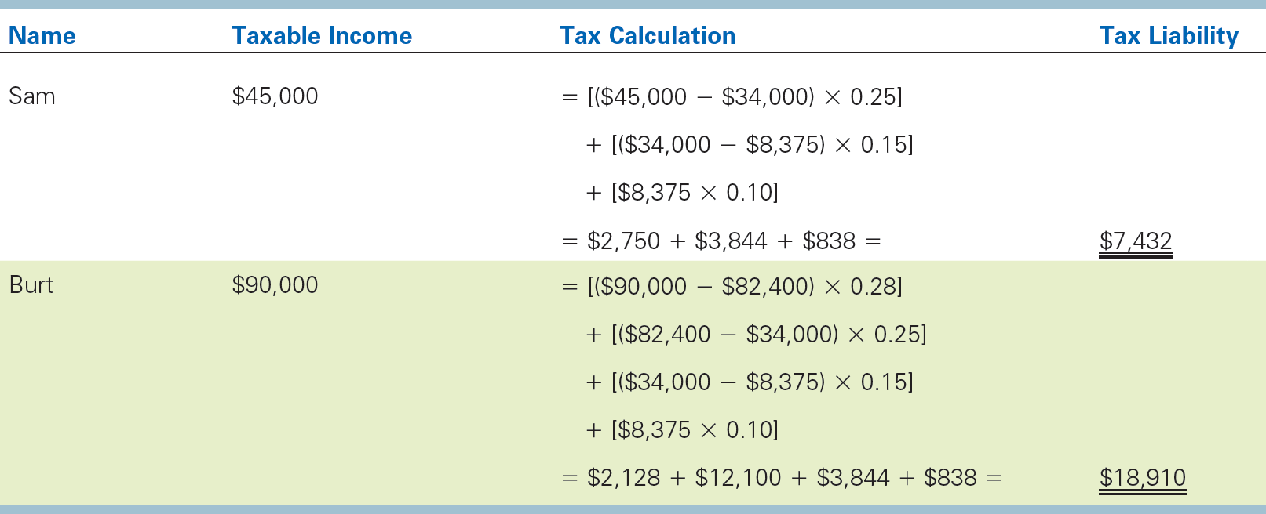
Sam and Burt’s Taxes

Slide 7
Filing Status Categories
Single – Unmarried or legally separated
Married filing jointly – married couples who combine income and deductions on 1 return
Married filing separately – spouses file separately
Head of household – considered unmarried pays more than ½ for self and dependent
Qualifying widow/widower with dependent child – spouse died within 2 years, has dependent child

Slide 8

Your Take-Home Pay
Taxes due on a pay-as-you-go basis
Employer withholds taxes all year
Self-employed deduct and pay taxes
Taxes include:
Federal, State, & Local income taxes
FICA and other withholding taxes

Slide 9
It's Taxable Income That Matters
Taxable Income = the amount of income subject to taxes
Calculating income taxes is a complex process involving several steps and many computations

Slide 10
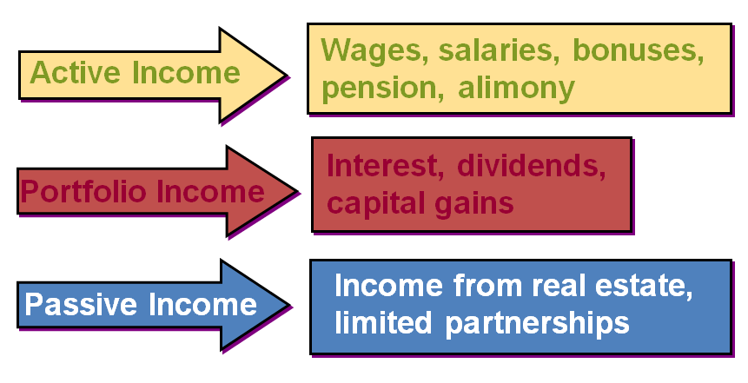
Three Kinds of Income

Slide 11
Gross Income
Gross income- any and all income subject to federal taxes.
Wages and Salaries
Bonuses, commissions, and tips
Interest and dividends received
Alimony received
Income from pensions and annuities
Prize, lottery, and gambling winnings

Slide 12
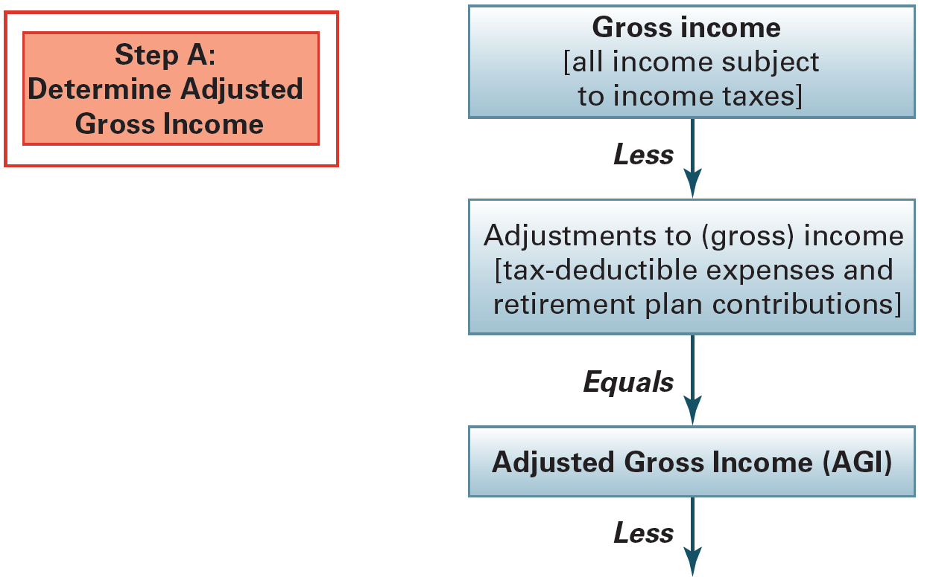
Taxable Income and Liability Part 1

Slide 13
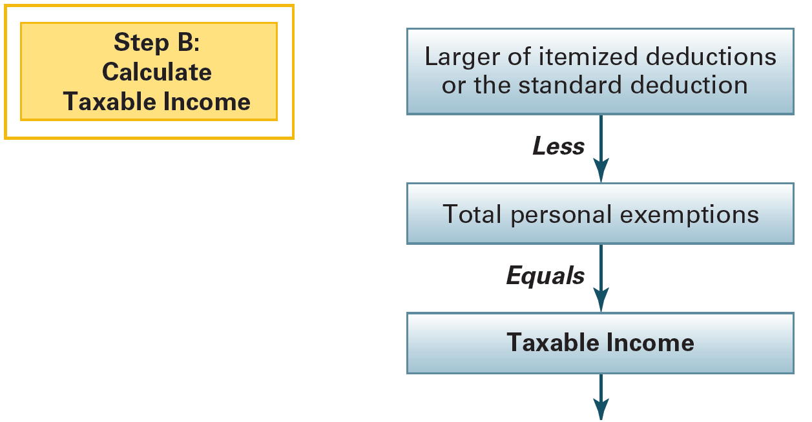
Taxable Income and Liability Part 2

Slide 14
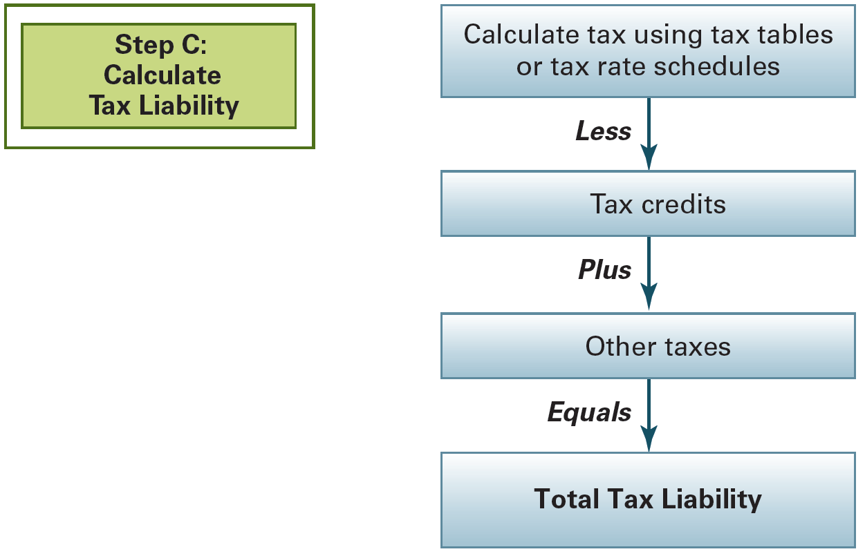
Taxable Income and Liability Part 3

Slide 15
Capital Gains
Capital gain (loss) – when an asset is sold for more (less) than its original cost
Capital gains are taxed at different rates, depending upon holding period.
Most capital gains are included in portfolio income.
IRS limits capital losses during a given year.
A capital loss must results from sale of some income-producing asset to qualify as “deductible”.

Slide 16
Capital Gains Tax Categories as of 2011
Capital gains tax rates are as low as 5% or 15% for holding periods over 12 months, depending on the tax bracket (year 2011).
Holding Period | Tax Brackets (2010) | Tax on Capital Gains
Less than 12 months | All (10%, 15%, 25%, 28%, 33%, and 35%) | Same as ordinary income
Over 12 months | 10%, 15% | 0%
empty cell | 25%, 28%, 33%, 35% | 15%
Notes:
Description of the table: Holding periods, tax brackets circa 2010, and taxes on capital gains are given.

Slide 17
Adjustments to Gross Income
These can be subtracted from gross income
Higher education (limited)
IRA contributions (limited)
Self-employment tax – (limited to 50%)
Alimony paid
Penalty on early withdrawal of savings
Moving expenses (limited)

Slide 18

Deductions: Standard or Itemized
Standard deduction – a fixed amount that depends on filing status
filing status
age
vision

Slide 19
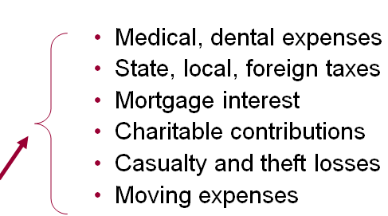
Deductions: Standard or Itemized (continued)
Itemized deductions
specific personal expenditures
itemize if expenses are greater than standard deduction

Slide 20
Exemptions
Deductions from AGI based on number of persons supported by taxpayer’s income
You are an exemption on your own return unless claimed by someone else
Children, spouses, elderly parents can be other exemptions

Slide 21
Tax Credits
Subtracted from amount of taxes owed
Credits include:
Child & dependent care expenses
Adoption tax credit
Foreign tax credit
Credit for Qualified electric car

Slide 22
Tax Credits versus Tax Deductions
Which results in lower taxes?
Credits
directly reduce amount of taxes owed
versus
Deductions
subtracted from AGI and reduce taxable income

Slide 23

Tax Forms and Schedules
When more detail is required, taxpayers also must file other forms and schedules

Slide 24

Tax Forms and Schedules-1040EZ
Form 1040EZ — Simple 1 page form
Under age 65
Taxable income under $100,000
Don’t claim
adjustments to income
itemized deductions
tax credits

Slide 25


Other Filing Considerations
Quarterly payment of estimated taxes
April 15 filing deadline
Filing extensions
Amended returns (1040X)
Audited returns

Slide 26

Tax Preparation Services
Do it yourself or get help from
Private tax preparers
Tax services
CPA’s
Enrolled agents
Tax attorneys
Computer-based tax returns
Taxpayer is responsible for accuracy!

Slide 27

Effective Tax Planning
Tax avoidance is legal - tax evasion is not!
Reduce taxes
Maximize deductions, credits
Shift taxes
Use gifts or trusts
Defer taxes
Postpone to future through IRA or annuity

